Slide 1
Detection of phishing URL with Machine learning
Name:

Slide 2
AGENDA
Introduction​
Aim and Objective
​Methodology
Conclusions
Future work

Slide 3
Introduction
Phishing ULRs is a growing threat where cybercriminals create counterfeit websites to lure their victims and obtain sensitive information.
Often these fake websites look similar to the real thing, and checking for telltale signs can help protect against URL phishing.
Organizations can minimize their risk by training users and adding automated defenses that screen emails.

Slide 4
Aim and objectives
This study aims to examine, propose, and evaluate a unique collection of features that may be use to predict phishing URLs promptly and accurately using a Machine learning method.
To meet the aims of the project, the research illustrates aims have been defined:
Dataset gathering & pre-processing
Identifying the most relevant sets of characteristics and applying them to develop a unique ML-based prediction model for detecting phishing URLs.
To assess the accuracy and efficiency of the result prediction models.

Slide 5
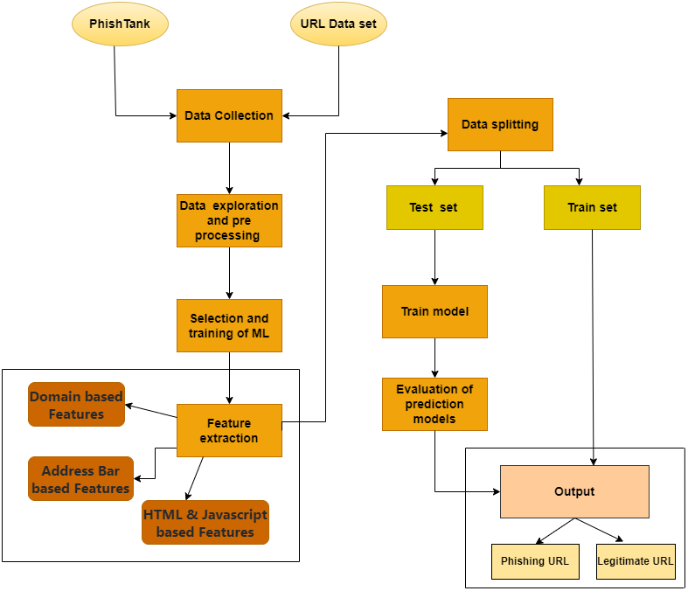
Methodology
Data set:
Phishing URLs for this study from the open-source website Phish Tank.
The other dataset was obtained from the open datasets of the University of New Brunswick. Thisdataset contains regular URLs, phishing, fraud, malware, or URL defacement. The URL dataset is being evaluated out of these types for this research. This dataset provides 4,000 unique random

Slide 6
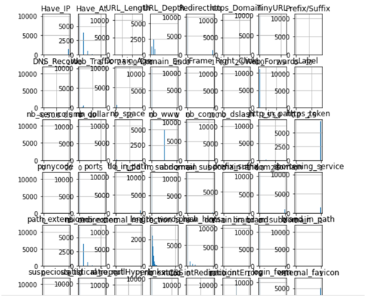
Features Selections:
The below mentioned category of features are extracted from the URL data:
Address Bar based Features
Domain based Features
HTML & Javascript based Features

Slide 7
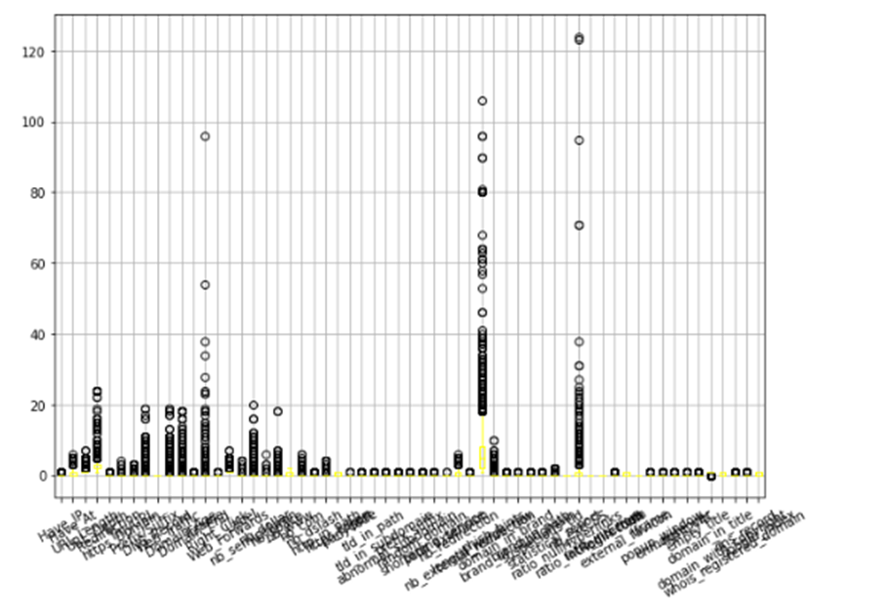
After dropping extra values

Slide 8
Machine learning Models
In this I used Supervised learning. There are two types of supervised machine learning problems called classification and regression.
This research dataset used classification problems as the input URLs is classified as Phishing (1) and legitimate (0).
Used Seven Machine learning models consider to train the dataset.
SVM
Multilayer Perceptrons MLP
Artifical neural network ANN
Ridge classifier
XGBoost
Decision tree
Random Forest

Slide 9
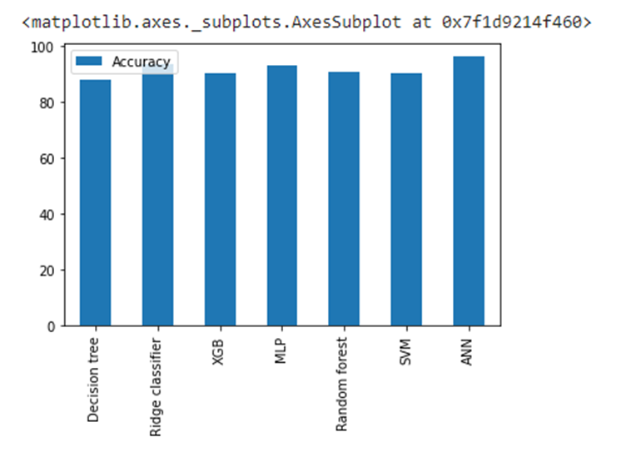
Model Evaluations
By comparing all accuracy results, ANN as high accuracy from above all ML models.

Slide 10
Conclusions
The outcomes of the research demonstrate that ANN Artificial neural network algorithms yield High accuracy rates as compared to other support vector machine SVM, random forestRF, Decision Tree, Ridge, MLP and XGBoost. The Artificial neural network ANN produces the optimum answer with around 96.3%.

Slide 11
Future Works
Techniques for feature selection will be able to reduce data dimensionality while improving classification efficiency.
Various textual aspects may also be analyzed to increase the efficacy of the detection procedure.

Slide 12
THANK YOU

